Slide 1
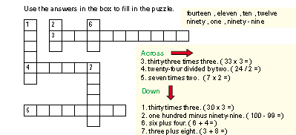
Lesson 1
Back to Unit 4

